Slide 1
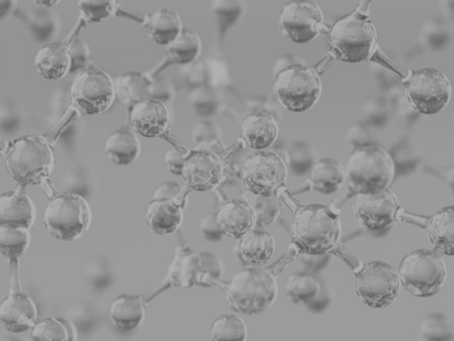


Onboarding Analysis of Glass SAMPLES
Zachary Chang
University of California, Los Angeles (UCLA)
Contact: zachang890@g.ucla.edu
Physics of AmoRphous and
Inorganic Solids Laboratory

Slide 2
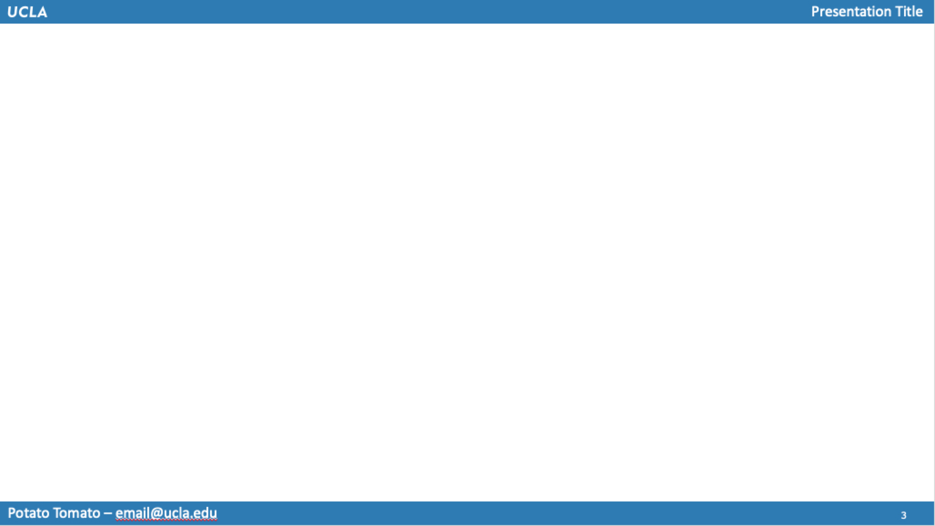

Background & Motivation/Goal
Data Provided: 1603 data points, Compound to element compositions [ex. Al₂O₃ = 2 Al + 3 O]
Type of Data (Relevant): Given chemical compound composition (compound mol %) & Young’s Modulus, Shear Modulus, and Poisson’s Ration
Goal for the Week: Familiarize with data & write functions to find weighted averages for relevant features & begin using RandomForestReg. & LASSO

Slide 3
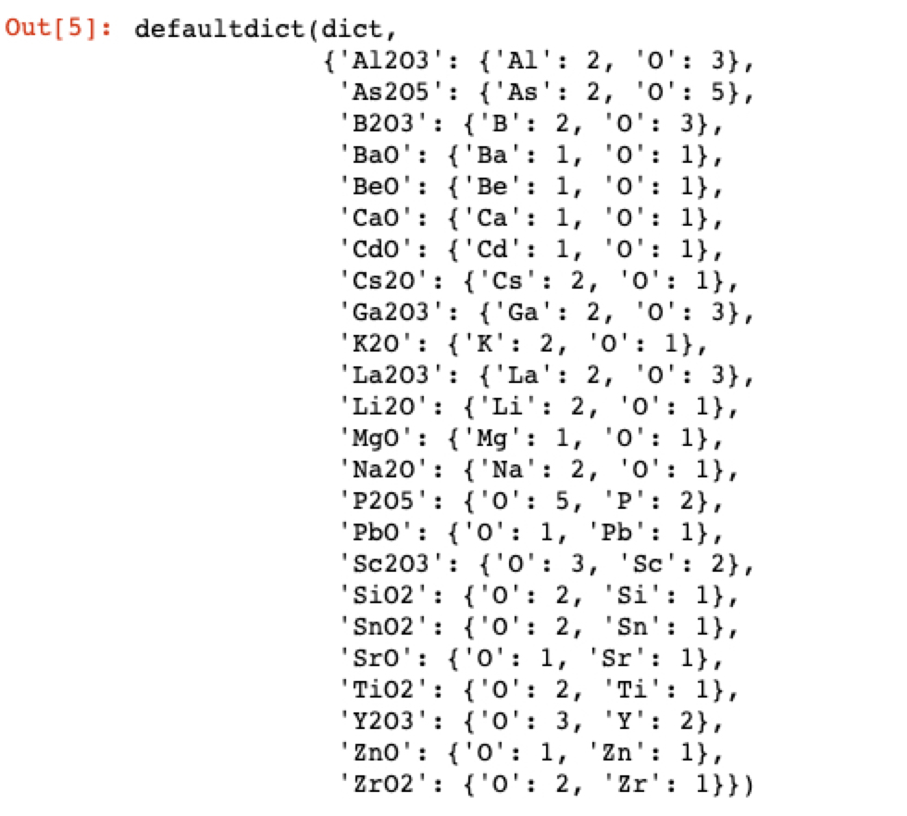
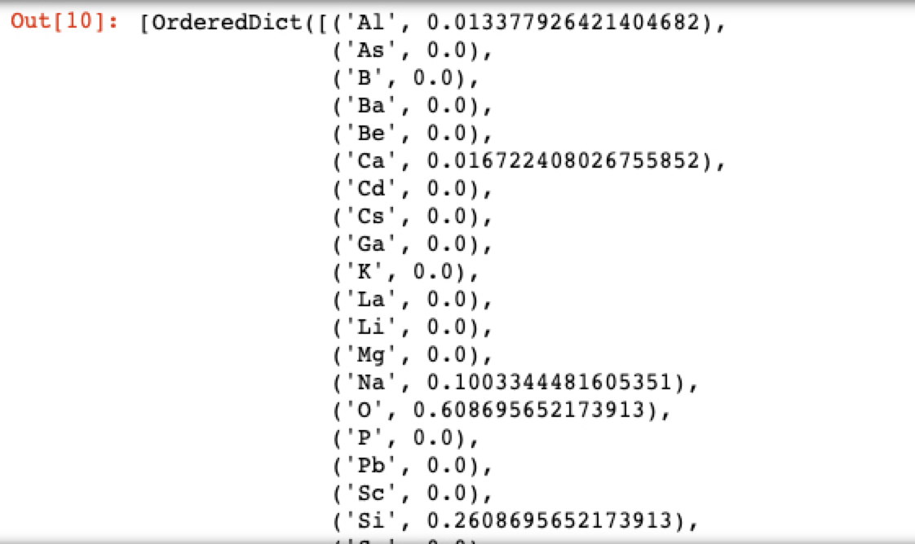
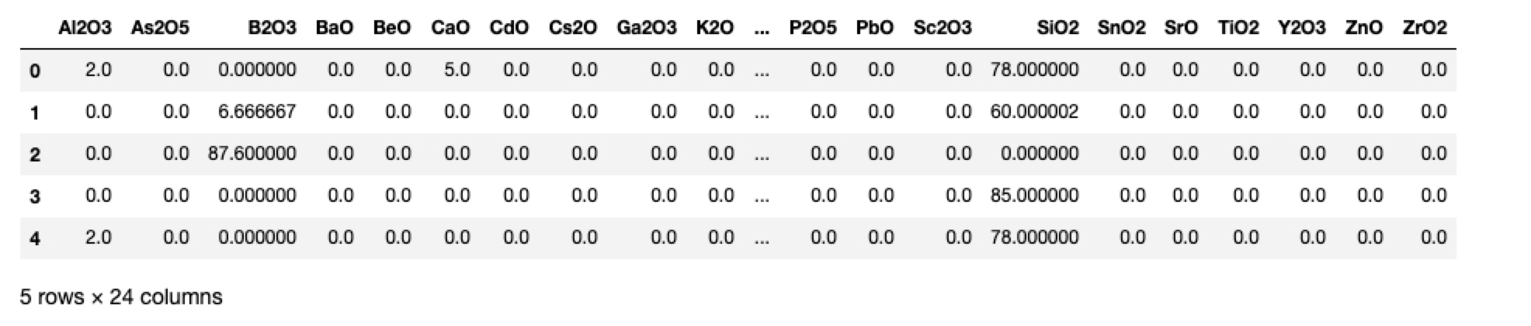
Process: Extract Atomic Mol %
Excerpt from N x P matrix of atomic mol %
[per-element weighted avg.]
Dictionary of makeup of chemical compounds
Use compound mol % values to construct a 1603 x 25 matrix where 1603 = number of glass samples and 25 = number of elements → matrix values are atomic mol % for each glass sample
Dictionary of makeup of chemical compounds

Slide 4
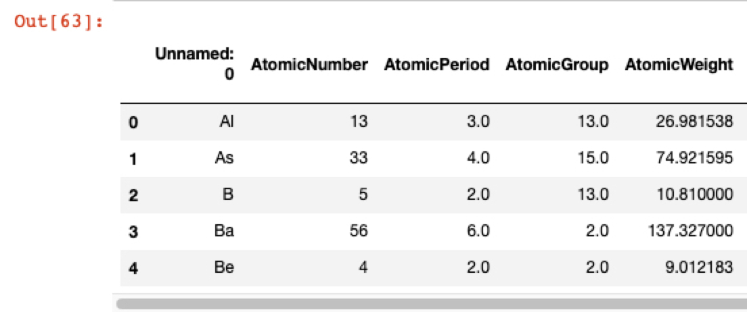
Feature Transformation
X
1603 x 25 Matrix with each glass sample’s atomic mol %
Introducing 25 x 12 Matrix with relevant features
Result: 1603 x 12 Matrix → weighted features

Slide 5
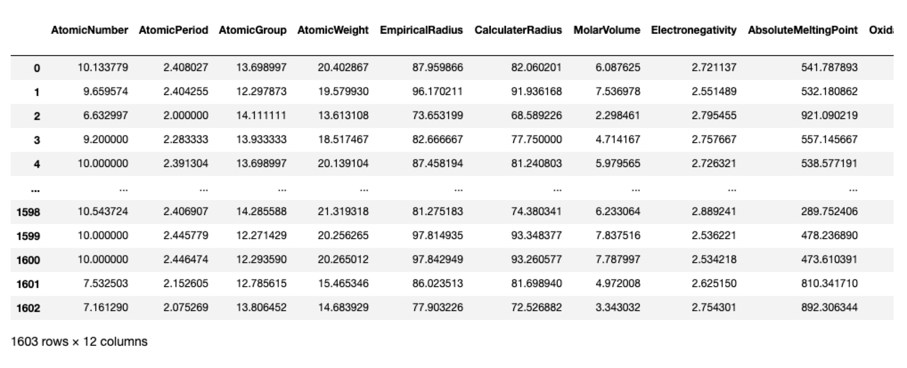
Weighted Features
Resulting Matrix

Slide 6
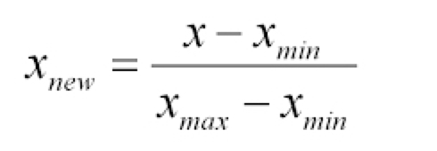
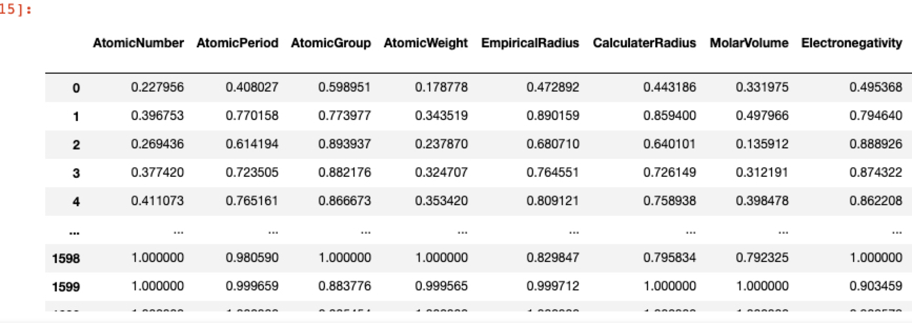
Feature Normalization
Basic Normalization function (bounds data in interval [0,1])

Slide 7
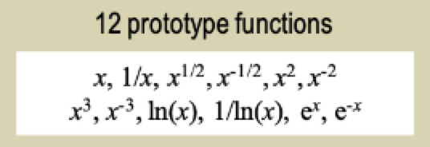
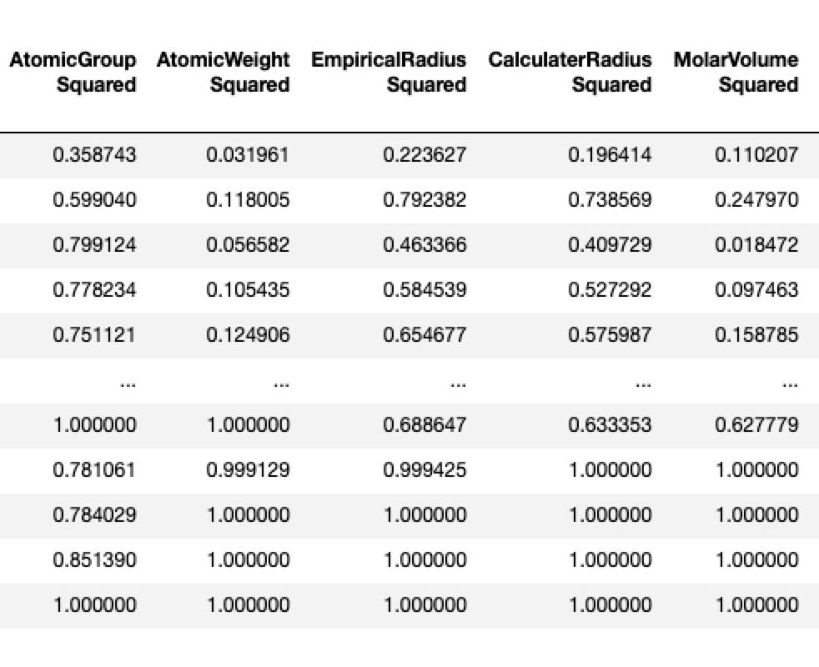
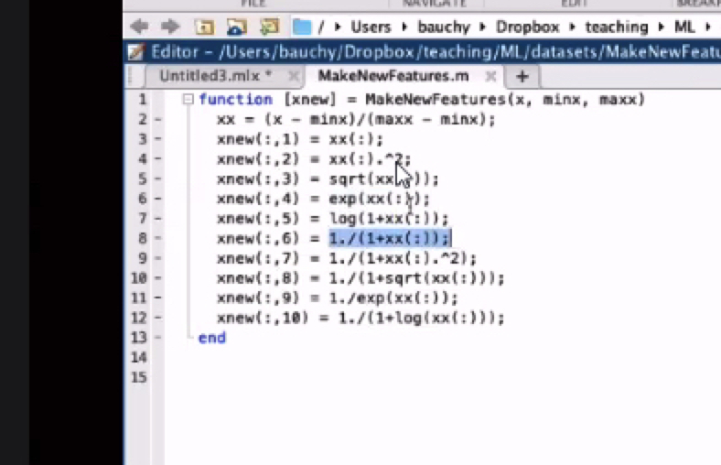
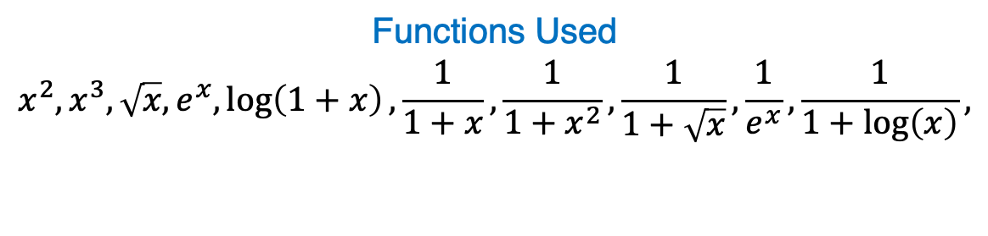
Transformations
From Paper
List of transformations Used:
Functions Used
$$x^{2}, x^{3}, \sqrt{x}, e^{x},\log\left(1+x\right),\frac{1}{1+x},\frac{1}{1+x^{2}},\frac{1}{1+\sqrt{x}},\frac{1}{e^{x}},\frac{1}{1+\log\left(x\right)},$$
Sample
From Video

Slide 8
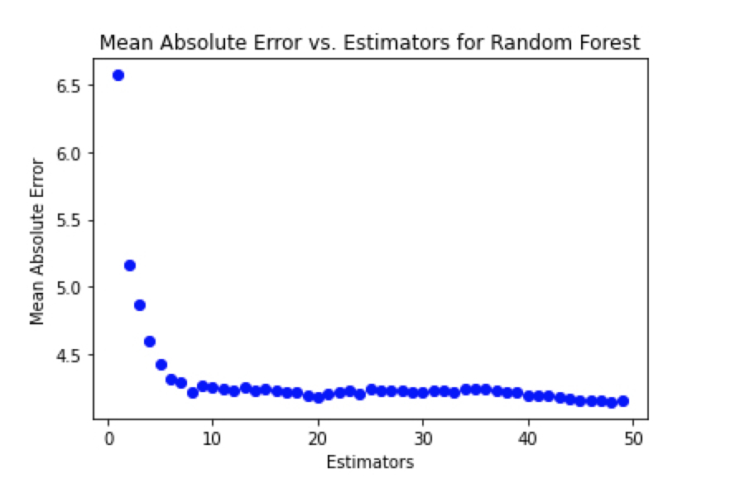
Random Forest Trial (w/o Feature Selection) – Young’s Modulus
List of transformations Used:

Slide 9

Conclusion: Next Steps
List of transformations Used:
Perform RandomForestRegression for shear modulus and Poisson’s ratio
Use LASSO to perform feature selection from 1st level mathematical transformations
Repeat RandomForestRegression with newly picked features
Organize into functions and classes

